Slide 1
Assessing Inquiry Based Science Learning:
Trends and Challenges
Smithsonian Science Education
Center
Daniel Alcazar-Roman
Washington, DC - USA

Slide 2
Overview
LASER i3 Project
Next Generation Science Standards
Using Measurement Topics and Transfer Tasks for long-term tracking of science practices

Slide 3
SSEC LASER i3 Initiative
The U.S. Department of Education has provided funding for the Smithsonian Science Education Center (SSEC) to validate its LASER model for inquiry‐based science education programs through a randomized controlled trial (RCT).
 | Actual Figures
# students, grades 1-8 | 73,889
# teachers | 1,163 (Y1) 1,075 (Y2)
% free/reduced lunch | 70%

Slide 4
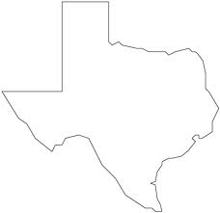
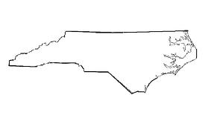
Our Regions
Houston (HISD)
835 teachers
51 schools
Impacting nearly 35,000
North Carolina
704 teachers
42 schools
Impacting over 30,000
New Mexico
432 teachers
33 schools
Impacting nearly 17,000

Slide 5
Regional Partners
The Los Alamos National Laboratory (LANL) Foundation in New Mexico
The Science, Math and Technology Center (SMT) in North Carolina
The Houston Independent School District (HISD) in Texas

Slide 6
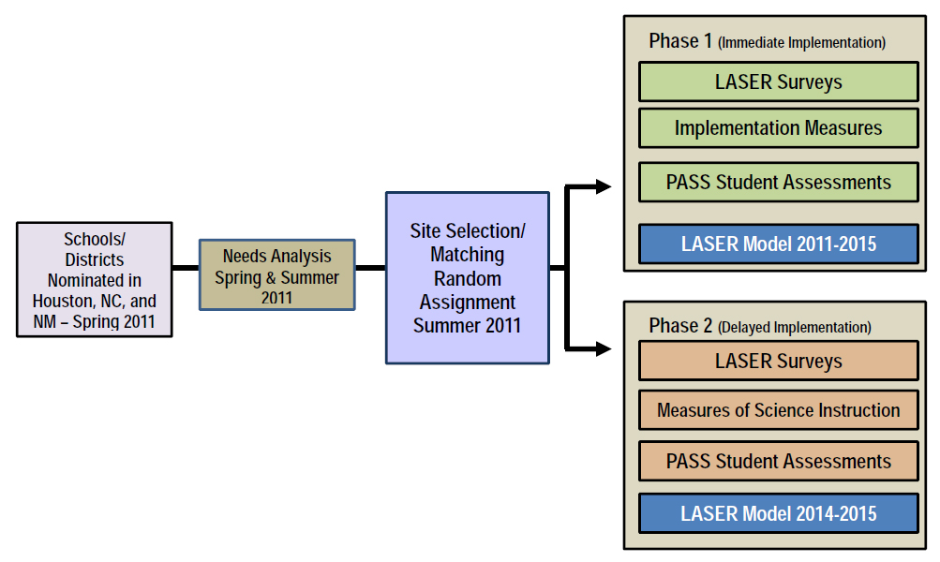
Laser i3 Research Study

Slide 7
LASER i3 Treatment
Leadership teams & strategic planning
Professional development (Summer Workshops & Condensed Kit Trainings)
Classroom science kits, including notebooks and inquiry-based materials

Slide 8
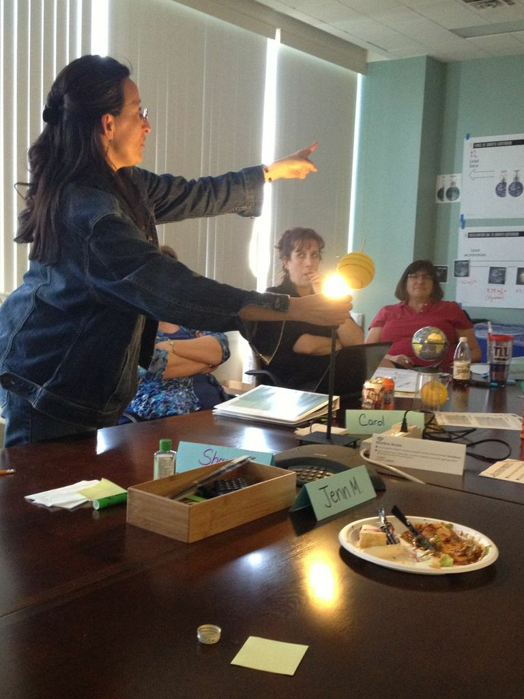
Facilitation Academies
53 teachers and curriculum specialists from all 3 regions
20 contracted trainers & 9 SSEC staff
Learning about the sun in “Planetary Systems”

Slide 9
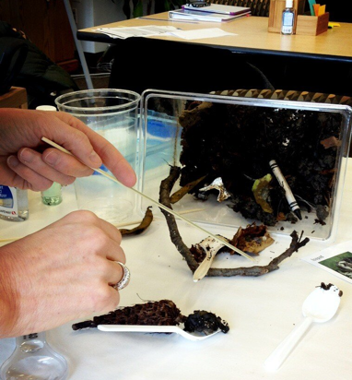
Facilitation Academies
Deepening content knowledge
Equipping co-facilitators for summer workshops
Building long-term capacity in regions
Exploring decomposition terrariums in “Organisms”

Slide 10
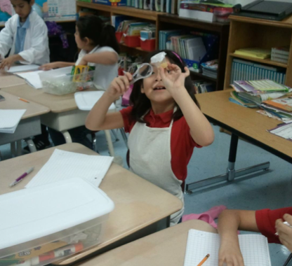
Program Evaluation
Unit Logs
Observations
PASS Assessments
Surveys
Interviews
Focus Groups

Slide 11
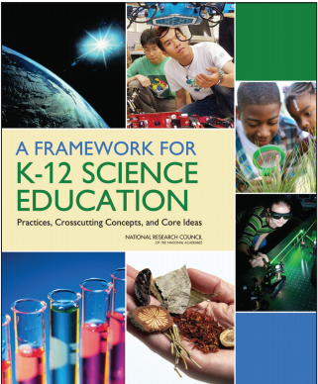
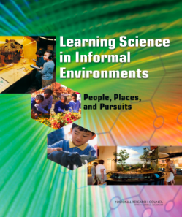
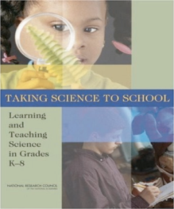
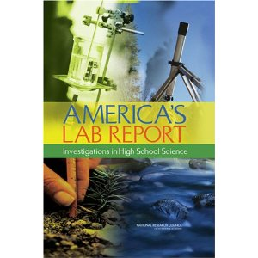
Next Generation Science Standards
Phase I
Phase II
1990s
1990s-2009
7/2010 – April 2013
1/2010 - 7/2011

Slide 12
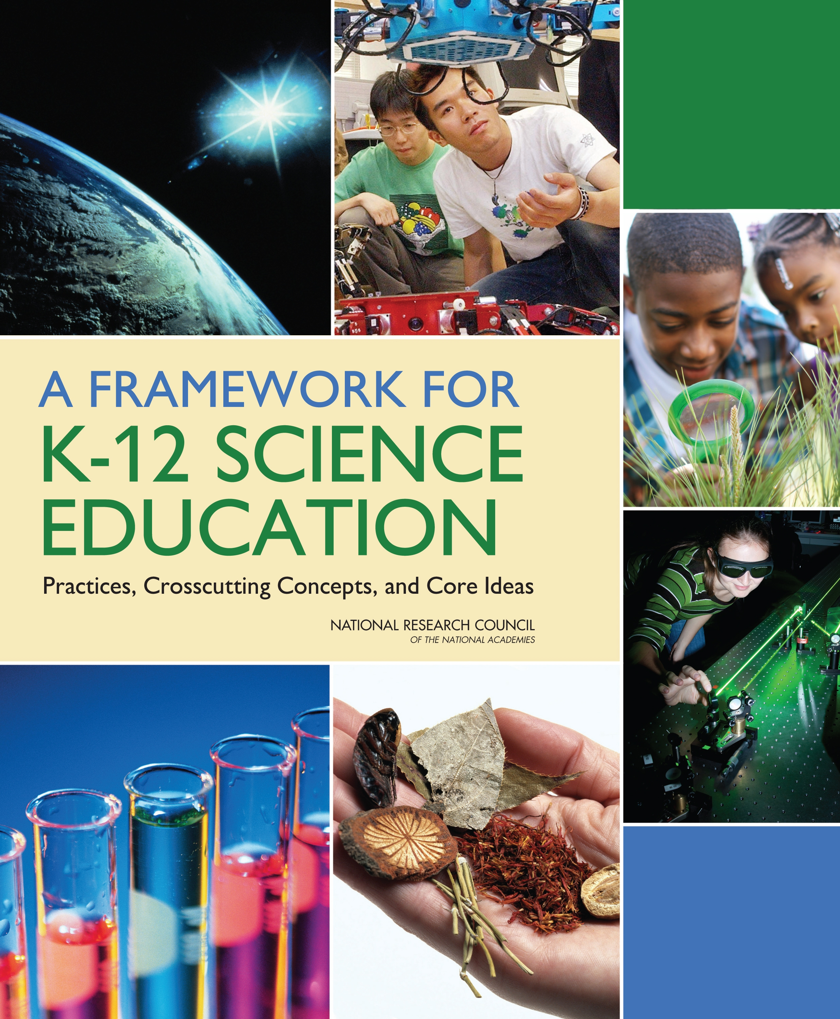
The National Research Council Framework and NGSS
Organized around core explanatory ideas
Coherence: building and applying ideas across time
Central role of scientific practices
Use of crosscutting concepts

Slide 13
Disciplinary Core Ideas
Disciplinary Core Ideas (DCIs) in four disciplinary areas:
Physical sciences
Life sciences
Earth and space sciences
Engineering, technology and applications of science

Slide 14
Disciplinary Core Ideas: Physical Sciences
PS1 Matter and its interactions
PS2 Motion and stability: Forces and interactions
PS3 Energy
PS4 Waves and their applications in technologies for information transfer

Slide 15
Disciplinary Core Ideas: Life Sciences
LS1: From molecules to organisms: Structures and processes
LS2: Ecosystems: Interactions, energy, and dynamics
LS3: Heredity: Inheritance and variation of traits
LS4: Biological evolution: Unity and diversity

Slide 16
Disciplinary Core Ideas: Earth and Space Sciences
ESS1: Earth’s place in the universe
ESS2: Earth’s systems
ESS3: Earth and human activity

Slide 17
Disciplinary Core Ideas: Engineering, Technology, and Applications of Science
ETS1: Engineering design
ETS2: Links among engineering, technology, science, and society

Slide 18
Crosscutting Concepts
Ideas the cut across and important to all the science disciplines
Patterns
Cause and effect
Scale, proportion and quantity
Systems and system models
Energy and matter
Structure and function
Stability and change

Slide 19
Scientific and Engineering Practices
The multiple ways of knowing and doing that scientists and engineers use to study the natural world and design world.
1. Asking questions and defining problems
2. Developing and using models
3. Planning and carrying out investigations and design solutions
4. Analyzing and interpreting data
5. Using mathematics and computational thinking
6. Developing explanations and designing solutions
7. Engaging in argument from evidence
8. Obtaining, evaluating, and communicating information

Slide 20
Content and Practice Work together to Build Understanding
Understanding content is inextricably linked to engaging in practices
Learning practices are inextricably linked to content.
Content and practices co-develop.
Crosscutting Concepts
Core
Ideas
Practices

Slide 21
Sample Performance Expectation Grade 5 Physical Science Student Expectation (5-PS1-2):
Students who demonstrate understanding can: Measure and graph quantities to provide evidence that regardless of the type of change that occurs when heating, cooling, or mixing substances, the total weight of matter is conserved.
Clarification Statement: Examples of reactions or changes could include phase changes, dissolving, and mixing that form new substances.
Assessment Boundary: Assessment does not include distinguishing mass and weight.
Core Ideas: Structure and properties of matter and chemical reactions
Practice: Using mathematics and computational thinking
Crosscutting Concept: Scale, proportion, and quantity.

Slide 22
Summative Assessment and the NGSS
Traditional Assessments
Use multiple choice items
Assess science declarative knowledge out of context
Rarely assess science procedural knowledge
Do not accurately record evidence of student thinking
May not capture higher levels of student performance
Performance or Transfer Tasks
Assess key concepts and practices by engaging students in real-life scientific tasks
Provide evidence of transfer including student thinking and understanding
Capture student misconceptions and higher levels of learning

Slide 23
Transfer Tasks
Performance tasks or transfer tasks allow educators to capture the kind of information that would best serve as evidence of scientific transfer.
These assessments tools engage students in investigations to demonstrate what they learned over many weeks in similar yet different contexts.

Slide 24
Transfer Tasks
Crosscutting Concepts are useful while creating tasks may produce evidence about learning transfer because they allow the assessment of concepts using different contexts.
For instance, if an instructional unit focused on investigating a core idea through the lens of systems and system models, a transfer task might ask a student to explore the structure and function of the parts of the same system.

Slide 25
Transfer Tasks
Transfer tasks also allow students to demonstrate a particular Scientific or Engineering Practice.
For example a transfer task that requires students to explore the Crosscutting Concept of scale, proportion, and quantity, would also assess the Practice of analyzing and interpreting data.

Slide 26
Sample Transfer Task
You will plan investigations to help Caroline better understand changes in matter. Lisa found her sister Caroline stirring her iced tea madly. Caroline said that she was trying to make sugar melt. Lisa told Caroline that what she was actually doing was dissolving the sugar, not melting it. Caroline was confused. She said that she knew that lots of things melt such as ice cream, ice cubes, candy in her mouth, sugar in hot tea, and chocolate. After thinking about it some more Caroline, concluded that melting and dissolving were the same thing. Your job is to design a series of investigations that Caroline could follow so that she can learn the difference between melting and dissolving. Be sure to include: Clear directions for the activities (include diagrams and pictures). A list of materials and tools that are needed. Sample graphic organizers that Lisa can use to record her observations. Teacher notes with the expected results for each activity and the patterns that would be observed during the melting or dissolving.
This Transfer Task targets the Practice of planning and carrying out investigations and the Crosscutting concept of analyzing patterns.

Slide 27
Transfer Tasks at Alexandria City Public Schools (ACPS)
At ACPS we determined that our K-12 science measurement topics would match the NGSS Practices and Crosscutting Concepts.
For each measurement topic we developed rubrics in grade-bands (Kindergarten-2nd, 3rd-5th, 6th-8th, and 9th-12th).

Slide 28
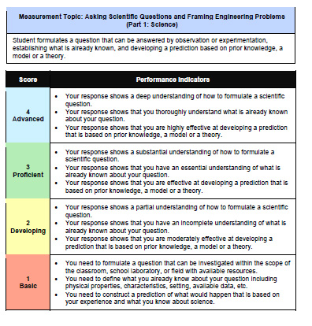
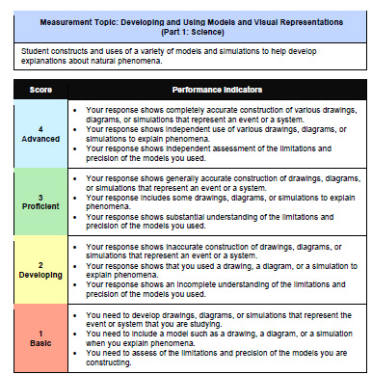
Transfer Tasks at ACPS
Each transfer task targets two measurement topics (one Practice and one Crosscutting Concept).
The corresponding rubrics provide performance descriptors. They also provide teachers with sample language to use as feedback for their students.

Slide 29
Transfer Tasks at ACPS
Performance is tracked from year to year.
Transfer Task performance are also used as part of a larger comprehensive assessment plan that includes classroom formative assessment, to monitor the quality of our curriculum and instruction throughout the school-year.

Slide 30
Assessing Students in Constructing Models
Greater sophistication
Grades K - 2 | Grades 3 - 5 | Middle School | High School
Develop a simple model that represents a proposed object or tool. | Develop and revise models collaboratively to measure and explain frequent and regular events. | Develop models to describe unobservable mechanisms. | Develop, revise, and use models to predict and support explanations of relationships between systems or between components of a system.

Slide 31
Assessing Students in Constructing Arguments
Greater sophistication
Grades K - 2 | Grades 3 - 5 | Middle School | High School
Make a claim and use evidence | Construct and support arguments drawing on evidence, data, or a model. Consider other ideas. | Construct and present oral and written arguments supported by empirical evidence and reasoning to support or refute an explanation for a phenomenon. | Construct a counter-argument that is based in data and evidence that challenges another proposed argument.

Slide 32
Large Scale IBSE Assessments
The National Assessment of Educational Progress (NAEP) in science includes interactive computer tasks and hands-on tasks are designed to assess how well students can perform scientific investigations, draw valid conclusions, and explain their results.

Slide 33
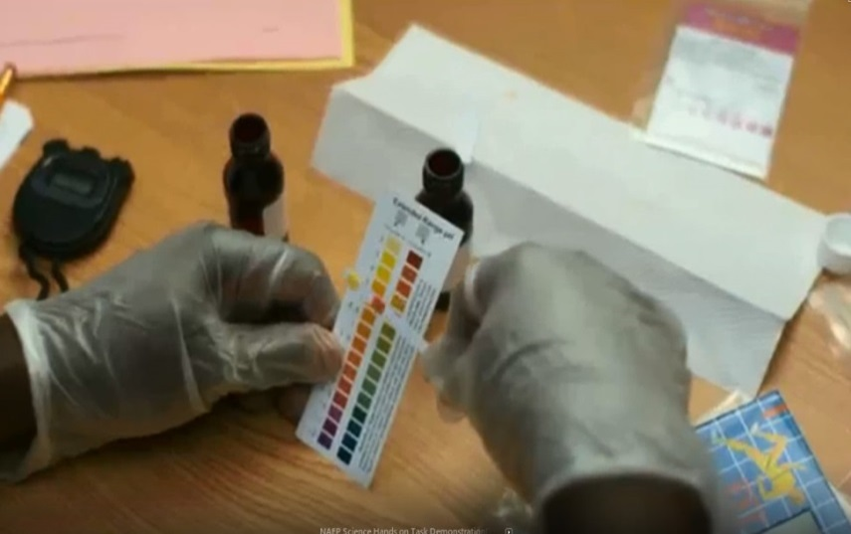
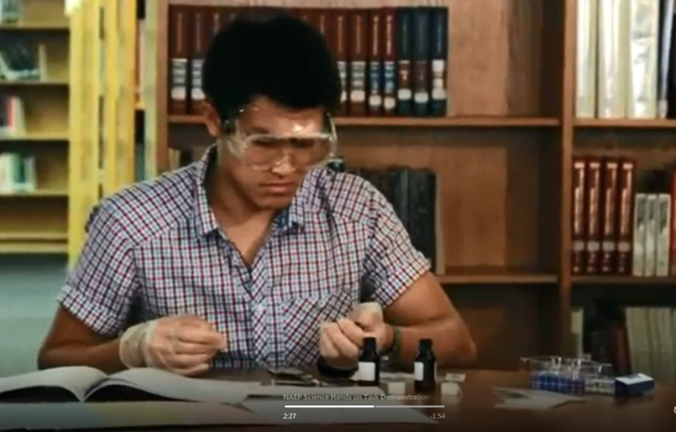
NAEP Hands-on Tasks
Hands-on tasks have been used in NAEP since the 1990s. These tasks present students with open-ended scenarios that require a deeper level of planning, analysis, and synthesis.

Slide 34
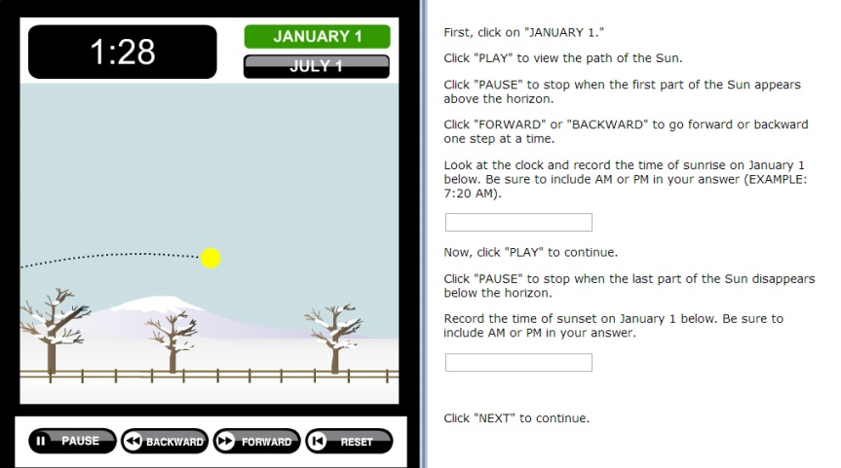
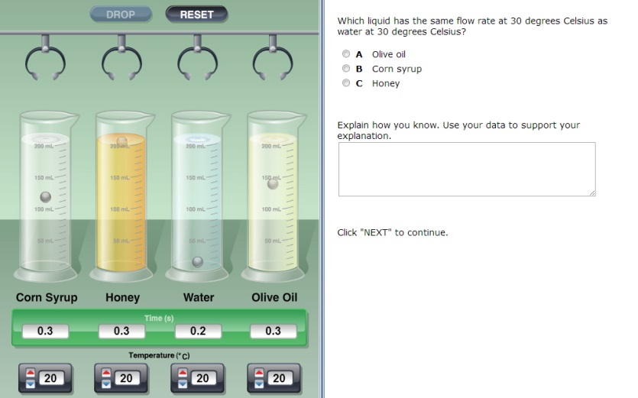
NAEP Interactive Computer Tasks
In 2009 for the first time, the NAEP science assessment also included interactive computer tasks in science. While performing the interactive computer and hands-on tasks, students manipulate objects and perform actual investigations, offering us richer data on how students respond to scientific challenges.

Slide 35
Large Scale IBSE Assessment
Sample questions, scoring criteria, and student responses can be found on the The Nation’s Report Card website: http://goo.gl/BdtqOt

Slide 36
Self-Assessment and the Scientific and Engineering Practices
1. Asking questions and defining problems
2. Developing and using models
3. Planning and carrying out investigations and design solutions
4. Analyzing and interpreting data
5. Using mathematics and computational thinking
6. Developing explanations and designing solutions
7. Engaging in argument from evidence
8. Obtaining, evaluating, and communicating information

Slide 37
Long-Term Challenges
Adoption of science standards that support inquiry-based science instruction and learning
Development a better culture of formative assessment supported by teacher training and the development of a repository of sample student work at different levels
The implementation of a large-scale science assessments that would support inquiry-based science instruction
Re-thinking evaluation models that directly link student performance to rewards and punishments for teachers

